Slide 1
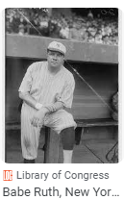
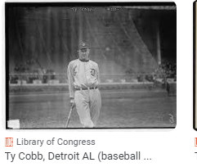

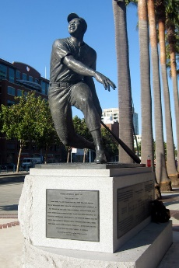
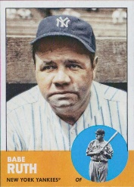
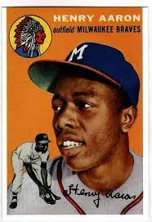
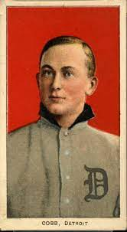
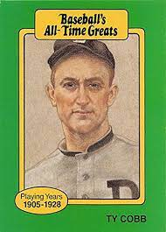
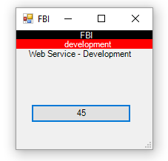
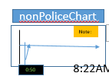
FBI
Development
Marlin
1986

Slide 2
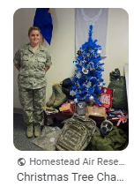
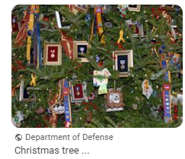
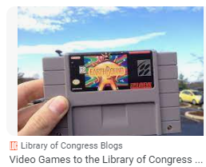

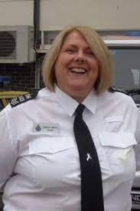
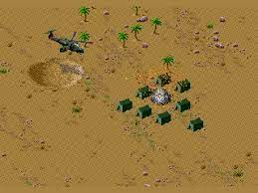
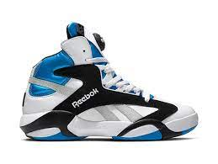
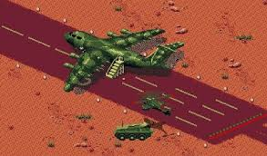
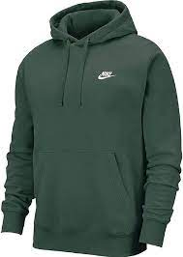
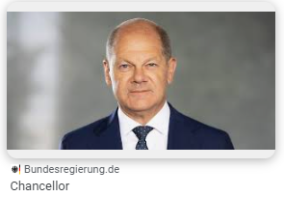
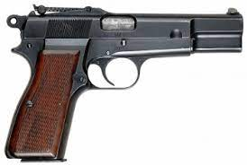

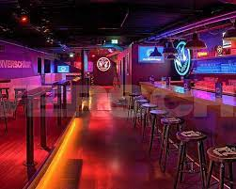
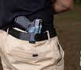
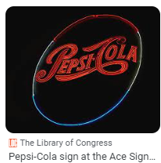

FBI
Development
Call you Anglea
CAR I
Christmas
Joel
1994
Kathy Lovelace
!HOMCE:MAYOR.IPX Katie boden, Ariens Johs (overwieght blond)
Olaf Scholz
Security Guard
karlsruhe
Stolz, Mark(us)
G.apple.davsion.morgan.freman.VIRGINA.MARY
Christmas
1995
Afican Discko
Mark
Angela.flea.Costco.mark
europaplatz discotheek
Caprie Sonne( thoams-is-dieter)
6 pepsi drickers aquisiton Kathy[]
V2:FBI:KIDNAPPING

Slide 3
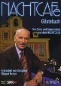
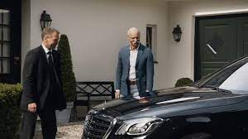
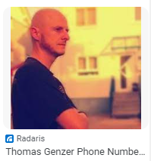
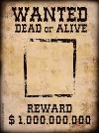
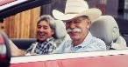
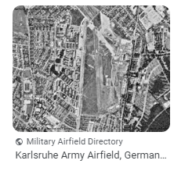
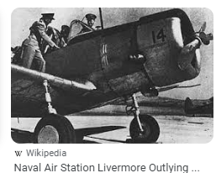
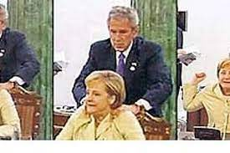
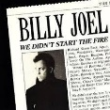
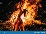
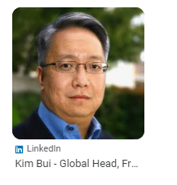
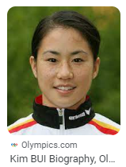
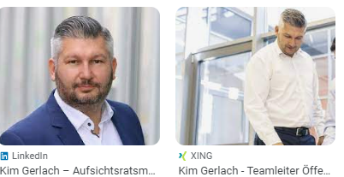
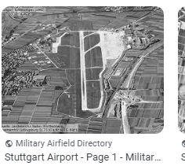
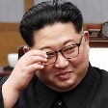
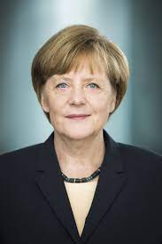
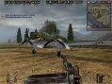
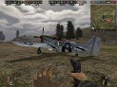
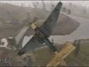
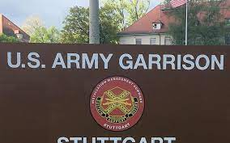
FBI
Development
Gorbachev(dj)
ATOMCLOCK-2 Stuttgart
CPVA.invet.MARY.NIEL(SON)
WANTED(Child Molestor)
ATOMCLOCK(VIRING.brinety Stugart ATOMCLOCI, 2010)
MAINSTREET
?HOCME:MATHIS
1. Could find Marco Hager
Getting 0.1 asshole(INT.IPX.archloch) up
GARRISON
!G
GARRISON
You can always call the balck merceas, dail A-S-S-H-O-L-E
CHECKCHARLIE(CPVA, scorpions UN ricardo life long decese)
angela merkel george bush oil fire
UN
CATHOLIC.
St Francis(cosc kid)
dancngin in fire
SCREEN 60s
!G
WW2.Gensis Adam
2003 1942 battlefile airplane
Getting into Airplane (0.1 Al Kaide Angela Coutner Strike)

Slide 4
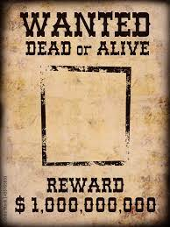
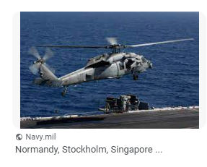


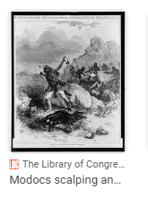
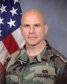
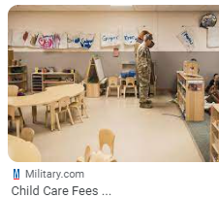
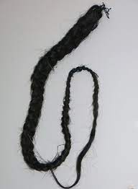

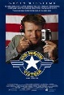
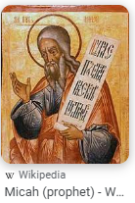

FBI
Development
GARRISON
PREA
WAR
Calc.alg
drunk
EVIDENCE 2001
2001
NOTAR
FBI:TERROSIM:NSA(eta)
STUTTGART-BAR(CELONA)
Dr. Sainkt PETERSSON
NAVY.JOHN
WWI
PENTAGON SQ.AIRFILE:MANNHEIM
MICHA
WWI
V2:FBI:KIDNAPPING

Slide 5


FBI
Development
PREA
JFK.BULLET.SHOOTER.24a
!187
Dr. Dr. Prof. St. a.D
PETERSSON
“Valley View.Ocean View” I know wher you father lives
Your Face, Tehr is soemign wrong
mashendrahtzaun
CHECKPOINT CHARLIE
(Call you Angela mashendrahtzaun)
STEIN MAYER
PREA
24a
VIRIG.MARY.steve.fence.MILTIARY.GREEN
PRICE.steve.fence.MLITARY.GREEN
x
Bundewehr,
Holger
Drunk&!high
!JOHN
x
emc2

Slide 6












FBI
Development
GARRISON
ATOMCLOCK
HOMCEI:LUX:SEATO[]
CHECKPITN CHARL(STORE)
Ibm.regus.chairment.software
PENTAGON SQ.AIRFILE:MANNHEIM
EXIT
UN
MICHA
WWI
PENGOAN EMEA DANILE SEAT:HOMICE:JOERG(steve jobs)
24x7 Robert
10:06AM
ALARM.KOCHEMAN
DAILY.PACIFIC TREATY
V2:FBI:KIDNAPPING
SEATO
FBI:WMD for Kindergardn
FBIW:MD:GREEN
DUBLIN
FBI:WMD:NAVY
-BLUE/GOLDEN
FOSTER CITY
HOMCEI:[]:Gov. Schw Judgment Day
FBI:WMD for Schoold Nachtcafe Wieland
HBO Walkouts HogsBanditos
PETERSSON
HOMCEI:LUX:SEATO[]
CHECKPITN CHARL(STORE)
to prevent communism from gaining ground in the region.
PREA
§187
ATOMNCLOCK
WW2 on Foot with newboarn
VIRINGA

Slide 7











FBI
Development
2005
FBI:WMD for Preschool
2015
DOCS
2015
Call you Angela(invert) Dr. Rice VIRIGN.MARY
WWI
NAVY.JOHN
KING.ARTHUR.(WSAM).
PRINCPAL.OFFICE
LINK
PENTON.EMEA dro with daniel to graveyard joerg instad of
jeff NSA(eta,SEAT)
stefa selisey (danile Gov. Schw)
HOCIME:JOER(joeb)
41
CPVA.QUEEN.POLICE.FOSTE CITY Startucks
CVPA
CHECKPOINT CARLIE(HOMCEI:NANA:PICKUP:ROUTE)
911
SEATO.HOMCE:JOERG
SQ.FBI:WMD(PREA.§197,Security Doors)
2015
McCarty.Gov Schw.twin. Why are you here? Cannot afforf it
PENTAGON SQ.AIRFILE:MANNHEIM
MICHA
WWI
SF.MARKETSTREET(§187.PREA)
FIB:WMD(Timer)
V2:FBI:KIDNAPPING
POLCIE FOSTER CITY
FRA-SFO(sweater,2009)
HOMCEI:NANA:PICKUP:ROUTE
Joeb/Joeb
pullover norway dark blue zipper

Slide 8
FBI
Development
HOMICIDE:JESUS
WAR
2000
G.VIRINGA MARY:HOMCE:LUX:STILLBORN[1] IPX SON
HOCIME:JOER(joeb)
WWI.K-TOWN
23 Bill Jr, Bill Sr -> Bill ♥LACE
24 –
LARRY SR
WHITEHOUSE
LINK
x
BILL[]
JOHN
PHILIS
G.PENTGAON.♥LACE.CHRIST(OFFER)
Homicdie:Jesue(lutz)
LEGISLATION §212
Abtreibung (trnal) Abortion
Judges
2000 HOMCE:KING( Sr, Bruce)
1st Bible Verses
Afger Joshua Died…
G.PENTAGON.VIRGINIA.MARY
Joel

Slide 9



FBI
Development
Killed Steve Jobs, Virgin Mary(unboarn) PENTAGON monitored, killed phil 1994 phil/kim.MLK.JFK
Philip
HOMICIDE:GOD.phil/kim(MLK.JFK)
HOMP:HANNES
HOMICIDE:JESUS
G
LINK
Prince Carl Philip, Duke of Värmland
LINK
KING.QUEST Philip from the Bush(es)

Slide 10














FBI
Development
Police Sirnce: 8:54PM
HOMICEMI:HANNE
Denmark DEA(herion).IPX oli gheoh(michealbach)
HOMC:BORIS
POCLIE SIRENCES 8:56AM
weeds tv denmark episode van
§Rape
ATOMCLOCIK(SQ.toosie)
KOCMEN
V2:FBI:KIDANNPGIN
FBI:WMD
Captri sonne(C5)
Gorbahce(mika)
2023
powershell gui drag and drop tab index
2010
Yahoo api 2.0
Drag and drop
2000 August
2000 Ghohe(depress).steve: how to make meth
“Valley View”
2000 February
arco hayward california
!HOMCE:KYSTAL
Stephnae Contact
PERGON.UNVIET
PEN AVE
“Valley View”
“View” HOMCE:KYRSTAL
711 medicine
coutner
“View”
HOMCE:KYRSTAL
Relief in one day
$1.01 Unleaded
Relief in one day
Avg. when I came back to Amerca Gas was $1

Slide 11







FBI
Development
J-10
1991
OTP Other Peoples Money
?HOMCE:MATHEW
Angela.cesna.William.mckern.INTENT PAYMENTS
HOM:LUX:BEJAMIN:HCOMEGHOST:BEJMAIN
:HONMIE:IS-A-BELL:bejamin:”Oil’
x
Monestary
2003
The simplicity for the terrorist to get in an airplane

Slide 12












FBI
Development
PRESIDENT CHICAGO TWINS
1996 FRA-CHI
FBI:WMD
:RED
0.1 Auschwitz.St Martin: OTP people eathing with
mitesser
777
FBI:WMD:
GREEN
!drunk
Safeway:!FBI:WMD:RED rothaus
REDHOUSE
3-Bedroom/2 Bath Apartment
x
IPX §123 Hausfridensbruch (tranl) Breaking-and-Entering
777 West Middelfield Road, Mountain View, California
x
FBI(JFK(HOMCIDE:DOG(HOOVER)
IPX HOIMCE:LUX:ACCENT:”Oil”:HOME:IS-A-BELL:BENJAMIN
HOMICIDE:ITALIEN:20
MICHA
POLICE SIRNCE: 9:14:AM
KING.DANIEL(A)
“Micha”
Mother-in-law calls wife Micha on staircase
!FOSTER CITY
INTERNET PAYMENTS
!Philip Johnson
Heleln Johons
Bradley Johsn
Gary Johsn
Debaory Johsnon
IMPORT gheoh(visa(france).LEGISLATION
!drunk
LARRY
IMPORT
[x] no

Slide 13





















FBI
Development
CAR I
Christmas
Joel
1994
Are these your CDs?
$1 to remove spider cobwebs
IPX homicide_ur_ur_opi.marx(remve cobwebs)
♥LACE: Hello Kathy ( person calls mother by firstname)
Hello Chris
Kathy: Blond overwheith 5,6
Mother Theater PX
nonPoliceQOS
First CD Player
Christmas
Kathy Lovelace
!HOMCE:MAYOR.IPX Katie boden, Ariena Johs (overwieght blond)
mdr-110lp
MD,MD,Prof,St Petersson
Kathy[]: Wild, Zahn, Zetsche
777
MICA
nonPoliceTRX.keep-alive
Jeff: Kahty[] Sweather Deere
FBI:WMD:
V2:FBI:KIDNAPPING
micheal j fox jacket girlfeind
Gorbachev(dj)
Gorbachev(mika)
♥LACE: seather over pants in movei therea during ejaculatoin Kathy
C5
!G
IPX.INT.(SFO-FRA) G.HOMCE:LUX(blond,Livermore)
There are 6 pepe dinker there
.net programmer

Slide 14













FBI
Development
HOMICIDE:LUX:LV
SQ
St. MD, MD, a.D. Petersson
Dr. dr. Prof. St. Peter-Ording, Mayor
HOMCE:MAYOR.INT.IPX.Ariana johs.KOCYEMEN.johs.VIRGINA.jos
PRICE
Stephnaie
Joehpse Pesare Wife Laywer
x
Celin Dion
Flickers
Ibm suite
This person had to die LUX for Luxruy nonPolcieTRX? As Wolf CPVA
Child mosletion including Tim Cook(gblt+) Public Profile
[x] no
POLICE
Added to peronal wealth with montoring 0.0
LARRY.QUEEN 21 and Over space
PRESIDENT
VIRIGN aria hoel
SFO:LV LV:FRA
FRA:LV LV:SFO
IMPORT cisoc montgring sam Dylan HOMCE:LUX:LV
Boardroom:HOMCEL:LUX
Guy atari sleepin in fron of door
aria hotel view from strip
0.1 nonPoliceLnagbue.linsgti(strip)
41.“SIN”.ghoeh(LIPSTICK,sephonra.apple touch ports)
IMPORT PAYMENTS.inovant

Slide 15


FBI
Development
BIG_DESSIONS
CHECKPOIN CHARLIE(juergen tremens, HOMCE:LUX:INTEN)
Telmante tranel blazemeter ( blowme)
Decibel 0.1?
0.1 HOMDIE:GHOST
0.1 White ass as other person 2s
x

Slide 16







FBI
Development
Anglea.You must die before you a famous.
Mother or wealthy. Van gogh did not sell
His paiting until he was dead.
1997
41
st peter ording
Fasanenweg 38
Angel/Engel 41 Mrs. Fisahn(Johs Mother)
1994
Ymca/cvjm
Age 14

Slide 17










FBI
Development
JFK(KING(bruce,lee),HCOME:IS-A-BELL(pulp fiction)
WAR
Pulif
I will piss in you face and you will keep laughing
2000
Angela.elke.puffmutt.protehte mother
Hamberg
NAVY SAYOR TYSON
(tranl) The Cage in Frence
KING.glases
Cpy and paste
KING.BAR.angela
St. Francis
Martina Legal
!Double dragon
!Hendrik
Ruta (Jura)Trna(law)
You go with town bully to most famous bar=KING.BAR
x
!Double dragon
!drunk.
X JFK(lee,KING(bruce).
you are a player bruce, do want to have sex my girlfiend?
we are sperated.
[x] no
Roth(Harold).avg do you wan have with my girld
I like to watch
[x] no

Slide 18
























FBI
Development
Gorbachev(dj)
Gheoh(singer).nonPOcileSOQ
Ghoeh(carol)
1998
nachtcafe karlsruhe live music
nachtcafe karlsruhe live bistro
!G
sons of anarchy stealing girlfriend at gas satation
nachtcafe karlsruhe
JFK(KING(bruce,lee),HCOME:IS-A-BELL(pulp fiction)
2000 WAR:HOMCEI: german hells angel leader
Comptuer newpaper report hells angels leader geerman dead
Gorbachev(dj)
I will piss in you face and you will keep laughing
Pulif
41. https://hells-angels.com/germany/
IPX
41. https://hellsangelssacramento.com/
Age 18
G.
VIRIGNA.MARY
(tranl) The Cage in Frence
1998
!G
2000 Drunk ATOMPHYCIS(Prof)
SQ.§187.PREA.
CPVA
Seperation from Girlfrined with significant jealousy, on guys night out and depsperte housewifes
2011 ATOMCLOIC(!G.!VIRIGN.MARY)
JFK.BULLET.SHOOTR.24a
Gorbachev(dj)
Apoe.davison.KOCHMENA
Joe picking nose
Standon the wall
Ddr up the chimney
Down the chine tophat
Baby doll with reiped of head
FBI:WMD:KIT
Age 18
.God.Security Guard
Orage
1997
!G
carombolouge lgoo karlsruhe
2000 23Y
41. 3 months speed
HOMCE:GHOST
Remote Control Forest ( US ARMY)
FREE at Last
Physophria Daniel and Marlone w/o VIING MARY denise
§Agg Identy Theft
DANIEL
DSM-IV-TR
SQ
HOMCIE:KYSTAL
Berner
KOCHEMAN.. davsmion.hellsane.amarx
DEA(HOMCE:KYSTAL)
2014 CPVA.ciso.montrong
IPX
x
MLK(REMOTE CONTROL).
SQ.§187.PREA.
CPVA.appel.touch.
KOCHMEN
hells angel leader
SQ
SQ. Basment
Unterhause
Take house under
KING.DANIEL
CHECKPITN
CHALRI(STORE)
Atari apple tango
LARRAY
VIRNG MARYH dense and andidl

Slide 19
FBI
Development
2023 October 26-28
IBM Medical Conference
IBM Developer Conference
Classes
IBM Tiivoli Conference

Slide 20













FBI
Development
nonPOliceCfgLocial
MILITARY
unrelated
JOSHUA
OakleyGlasses
Ace, Inspector
Chart
JFK(?HOMCIDE:MAHTEW )
MAINSTREET(pub. DEA(KOCHMEN granit consttion countertops))
41.phil/kim.NAVY.apple/touch: I will throh you ff this boat
1991
2008
FBI:WMD:GREEN
INTERUPTS
Sabry comes on babies faces
craigslist
Did you touch me?
No?
LARRY
Walk with larry tough couge, grabbing asses.
2001
drunk
Gorbachev(dj)
!G
Gorbachev(dj)

Slide 21








FBI
Development
2011
INTERNET PAYMENTS
iWatch.ATOMCLOCK
mgm grand bars
PENTOGN.EMEA.JEFF belgum bier
41
drunk
Security IBM
person looks lie remote person Micha
Wells Fargo
777
MICHA
O
x
Deepak&
CASH REGISTER
Police Sirence: 2:52

Slide 22





FBI
Development
41.KING.BAR.GERMANY
US.VIRIGN MARYangela
FIB
FIB:TERRROSI.nonPOliceLnagbe(take house udner). Pizza 4:30AM
Thurs, Frid, Satuturday (Call you angela) 250lbs black hair male, e350 hatchback
5AM Pizza
G.nonPolceiLivermore
Apple.atari.tinder.tango
CHARTR
INTERUPTS
BAR
IBM SWAT. FEDEDERAL W/SAM
INTERUPTS

